Slide 1
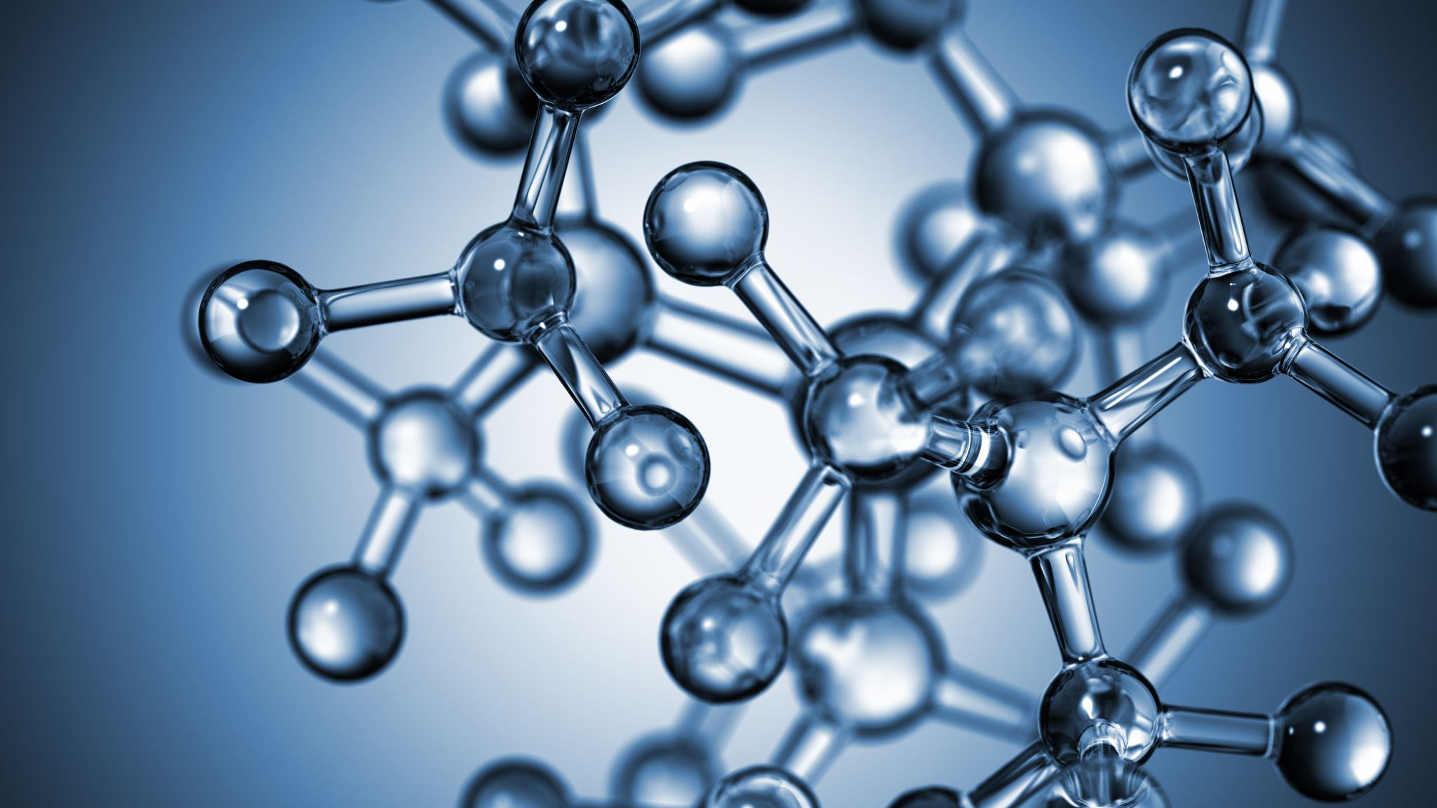


Brønsted-Lowry theory of acids and bases. Reactions that change the degree of oxidation.
Al-Farabi Kazakh National University
Faculty of Chemistry and Chemical technology
Department of General and Inorganic Chemistry
pHd Bakhadur askar

Slide 2
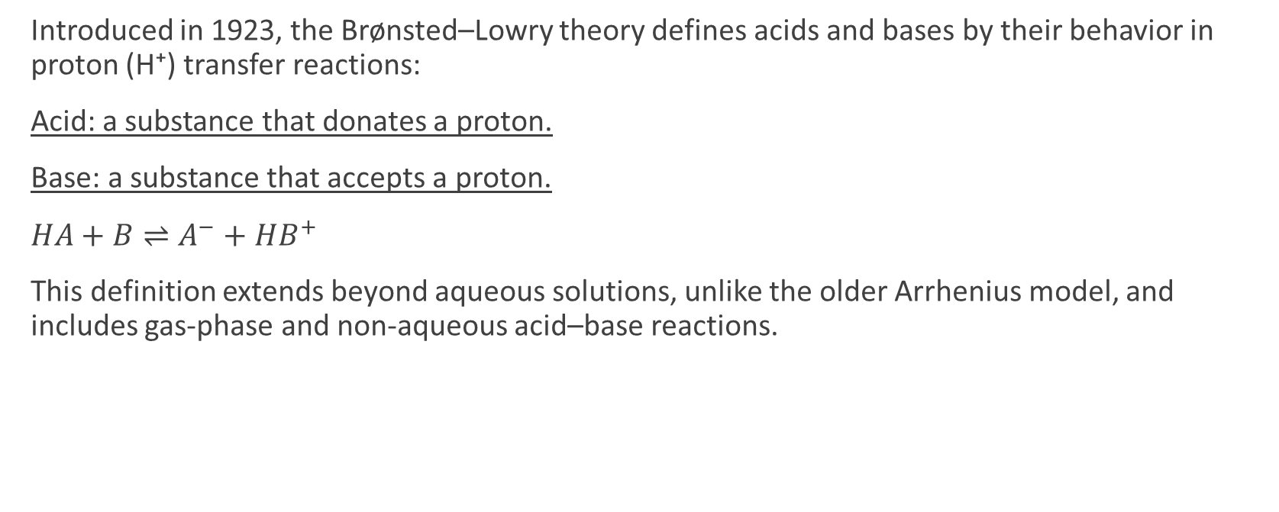
The Brønsted–Lowry concept
Introduced in 1923, the Brønsted–Lowry theory defines acids and bases by their behavior in proton (H⁺) transfer reactions:
Acid: a substance that donates a proton.
Base: a substance that accepts a proton.
$HA+B⇌A^{−}+HB^{+}$
This definition extends beyond aqueous solutions, unlike the older Arrhenius model, and includes gas-phase and non-aqueous acid–base reactions.

Slide 3

Conjugate acid–base pairs
Every acid–base reaction involves two conjugate pairs.
Example:
$NH_{3}+H_{2}O⇌NH_{4}^{+}+OH^{−}$
Each pair differs by one proton.
The strength of an acid is inversely related to the strength of its conjugate base.
Acid: H₂O (donates H⁺)
Base: NH₃ (accepts H⁺)
Conjugate acid: NH₄⁺
Conjugate base: OH⁻

Slide 4
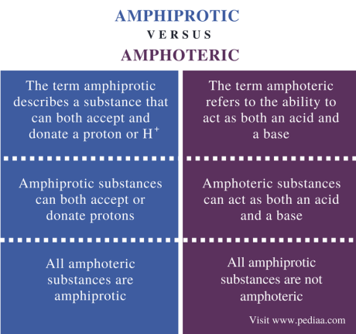

Amphoteric and polyprotic substances
Some species can act both as acids and bases, depending on reaction conditions — they are called amphoteric.
Example:
$H_{2}O+H_{2}O⇌H_{3}O^{+}+OH^{−}$
Water acts as both donor and acceptor.
Other amphoteric substances include Al(OH)₃, HCO₃⁻, and H₂PO₄⁻.
Polyprotic acids (e.g., H₂SO₄, H₃PO₄) can donate more than one proton in a stepwise manner, forming a series of conjugate bases.

Slide 5
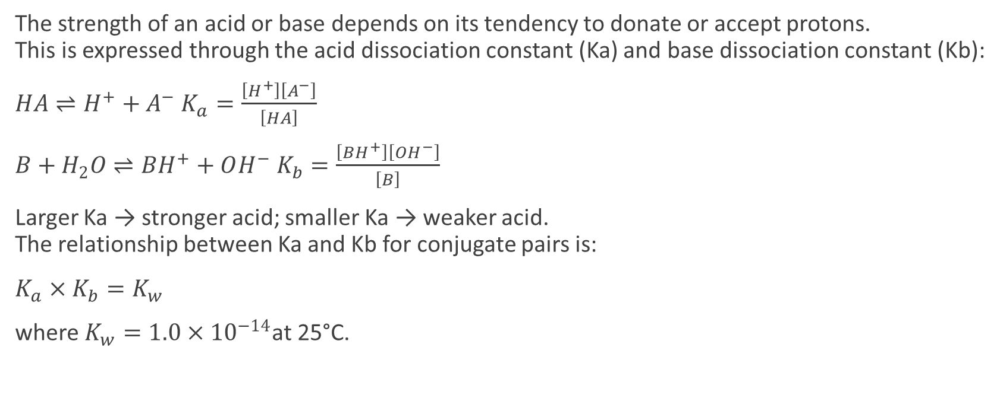
Acid–base strength and equilibrium
The strength of an acid or base depends on its tendency to donate or accept protons.
This is expressed through the acid dissociation constant (Ka) and base dissociation constant (Kb):
$HA⇌H^{+}+A^{−} K_{a}=\frac{\left[H^{+}\right]\left[A^{−}\right]}{\left[HA\right]}$
$B+H_{2}O⇌BH^{+}+OH^{−} K_{b}=\frac{\left[BH^{+}\right]\left[OH^{−}\right]}{\left[B\right]}$
Larger Ka → stronger acid; smaller Ka → weaker acid.
The relationship between Ka and Kb for conjugate pairs is:
$K_{a}×K_{b}=K_{w}$
where $K_{w}=1.0×{10}^{−14}$at 25°C.

Slide 6
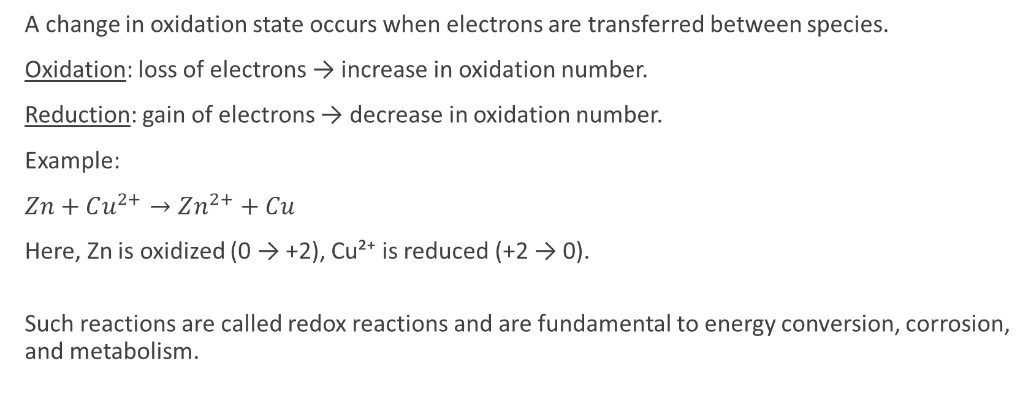
Reactions that change the degree of oxidation
A change in oxidation state occurs when electrons are transferred between species.
Oxidation: loss of electrons → increase in oxidation number.
Reduction: gain of electrons → decrease in oxidation number.
Example:
$Zn+Cu^{2+}→Zn^{2+}+Cu$
Here, Zn is oxidized (0 → +2), Cu²⁺ is reduced (+2 → 0).
Such reactions are called redox reactions and are fundamental to energy conversion, corrosion, and metabolism.

Slide 7
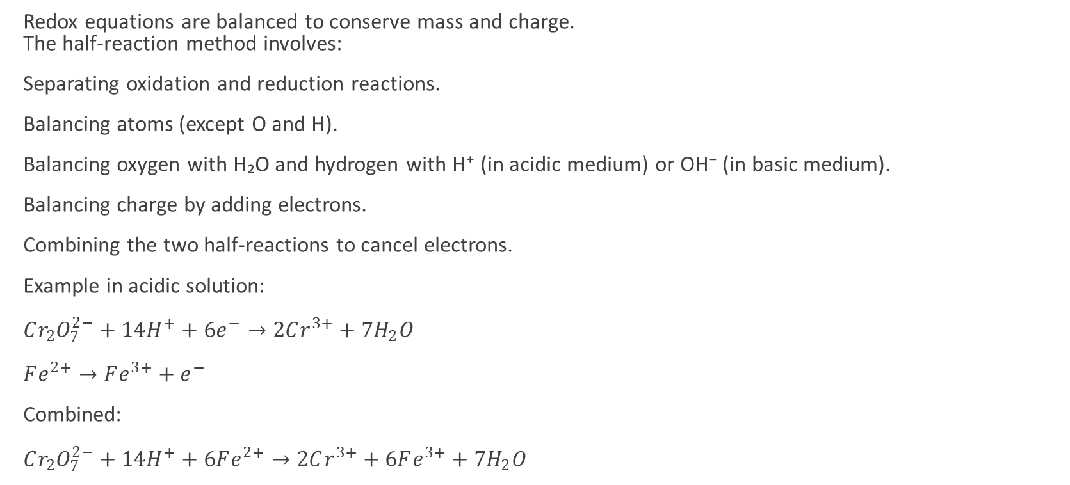
Balancing redox reactions
Redox equations are balanced to conserve mass and charge.
The half-reaction method involves:
Separating oxidation and reduction reactions.
Balancing atoms (except O and H).
Balancing oxygen with H₂O and hydrogen with H⁺ (in acidic medium) or OH⁻ (in basic medium).
Balancing charge by adding electrons.
Combining the two half-reactions to cancel electrons.
Example in acidic solution:
$Cr_{2}O_{7}^{2−}+14H^{+}+6e^{−}→2Cr^{3+}+7H_{2}O$
$Fe^{2+}→Fe^{3+}+e^{−}$
Combined:
$Cr_{2}O_{7}^{2−}+14H^{+}+6Fe^{2+}→2Cr^{3+}+6Fe^{3+}+7H_{2}O$

Slide 8
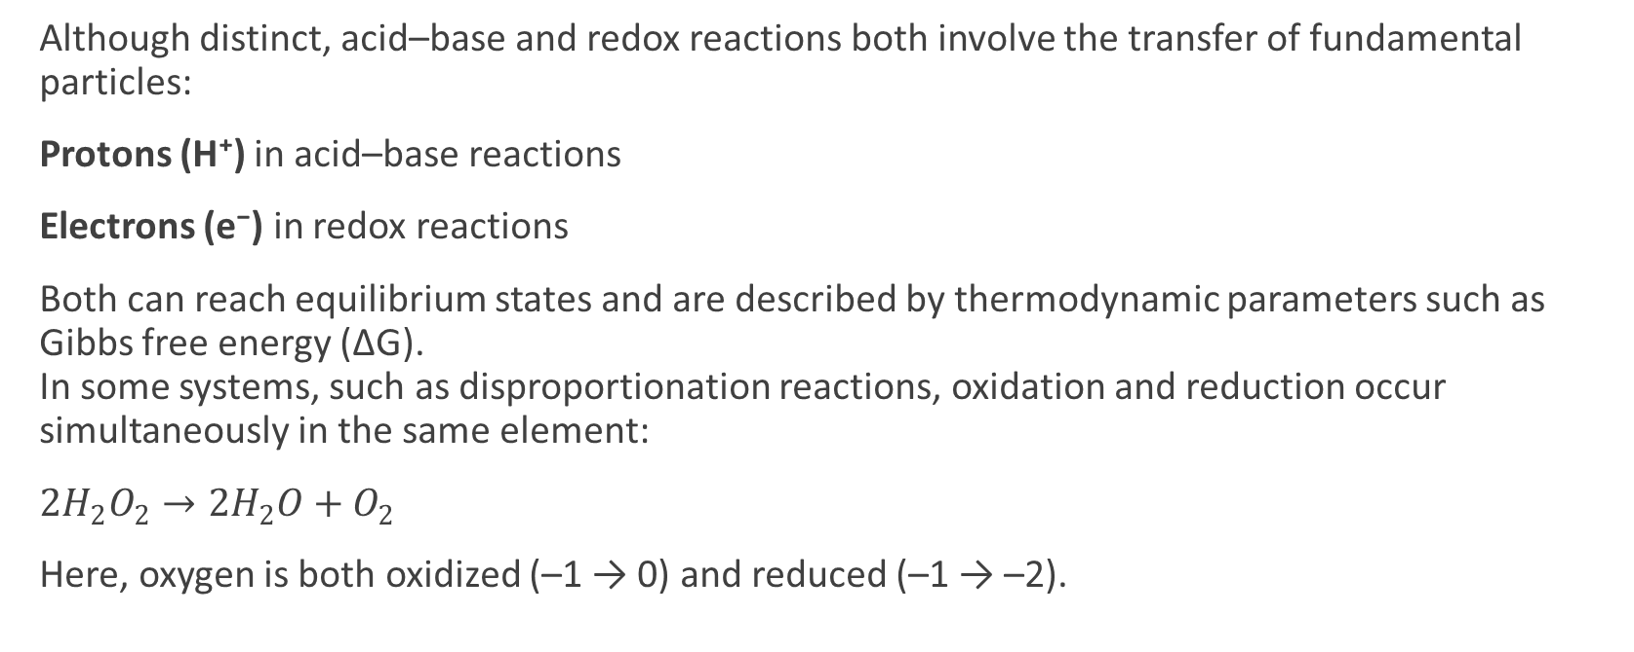
Relationship between acid–base and redox reactions
Although distinct, acid–base and redox reactions both involve the transfer of fundamental particles:
Protons (H⁺) in acid–base reactions
Electrons (e⁻) in redox reactions
Both can reach equilibrium states and are described by thermodynamic parameters such as Gibbs free energy (ΔG).
In some systems, such as disproportionation reactions, oxidation and reduction occur simultaneously in the same element:
$2H_{2}O_{2}→2H_{2}O+O_{2}$
Here, oxygen is both oxidized (–1 → 0) and reduced (–1 → –2).

Slide 9
Summary
The Brønsted–Lowry theory broadens the acid–base concept to any proton transfer reaction, explaining behaviors in aqueous and non-aqueous systems.
Each acid–base process involves conjugate pairs and can be described quantitatively with equilibrium constants (Ka, Kb).
Redox reactions involve changes in oxidation numbers and electron transfer, forming the foundation of electrochemistry.
Both theories demonstrate dynamic equilibrium and energy exchange in chemical processes.
Mastery of these principles is crucial for understanding reaction mechanisms, biochemical transformations, and industrial catalysis.
The Brønsted–Lowry model and oxidation–reduction theory together describe two major pathways of chemical change — proton transfer and electron transfer — providing a unified framework for predicting and controlling chemical behavior across diverse systems.

Slide 10

Questions?

